Slide 1

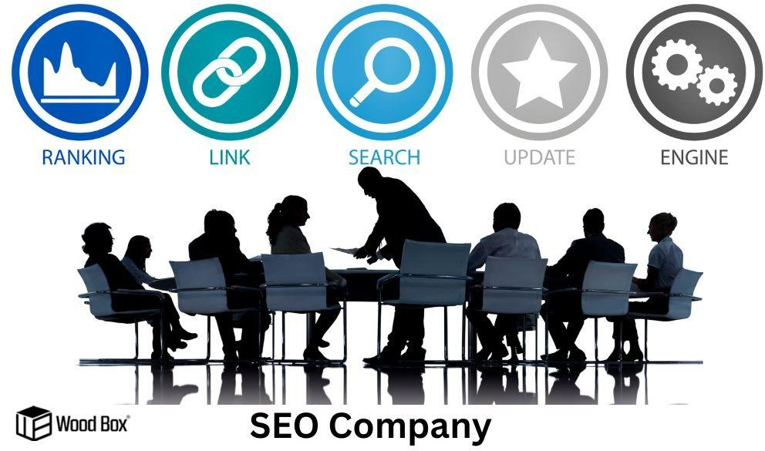
How to Improve Google Search Ranking with SEO Services in India
In the ever-evolving digital landscape, having a strong online presence is crucial for businesses of all sizes. One of the most effective ways to enhance your visibility is by leveraging the expertise of SEO services and search engine optimization companies in India. India, with its burgeoning digital marketing industry, offers plenty of opportunities for businesses to optimise their websites and climb the search engine results pages (SERPs). In this blog post, we'll explore how you can harness the power of SEO services in India and collaboration with search engine optimization companies to achieve higher search rankings and ultimately drive more traffic to your website.

Slide 2
Target Keywords: The Foundation of SEO
Keywords are the cornerstone of any successful SEO strategy, and working with an experienced SEO optimization company can help you identify and leverage the right keywords. They are the words and phrases that users enter into search engines when looking for information, products, or services. To improve your Google search ranking, you must identify relevant and target keywords that align with your business.
Keyword research is the first step in this process. SEO professionals in India can help you identify high-traffic keywords with the potential to bring in more visitors. Keyword intent, or the reason behind a user's search, is also crucial. Understanding whether users are looking for information, products, or services will help you create content that aligns with their needs.
On-Page Optimization: Fine-Tuning Your Website
Once you have your target keywords, including those recommended by the best-rated SEO companies, it's time to implement them strategically throughout your website. On-page optimization involves optimising various elements of your website to make it more search engine-friendly. This includes:
Title Tags and Meta Descriptions: Crafting compelling titles and meta descriptions that incorporate your target keywords can significantly impact click-through rates from the SERPs.
High-Quality Content: Creating valuable, well-researched, and engaging content is essential. Content should not only contain your keywords but also provide genuine value to your audience. Header Tags: Properly structuring your content with header tags (H1, H2, H3, etc.) makes it easier for search engines to understand your content's hierarchy.
URL Structure: Keep your URLs concise and include relevant keywords. Avoid long, convoluted URLs that may confuse both users and search engines.

Slide 3

Internal Linking: Linking to other relevant pages within your website improves navigation and helps distribute link authority.
If you are in any metropolitan city, such as Mumbai,Delhi, Kolkata, or Chenni services like SEO services in Mumbai can be instrumental in optimising your website's on-page elements, making it more attractive to search engines and increasing your chances of ranking higher in search results.
SERP Analysis: Gaining a Competitive Edge
Staying ahead of the competition is crucial in the online world. In India's competitive digital landscape, conducting SERP analysis can provide valuable insights. SEO professionals can help you analyse the SERPs to understand what your competitors are doing and identify gaps in their strategies.
By studying the top-ranking pages for your target keywords, you can gain insights into the content format, length, and quality that resonates with users. This information allows you to tailor your content and SEO strategy to outperform your competitors.

Slide 4
Technical SEO: The Backbone of Your Website
Technical SEO is often overlooked but is essential for a well-optimised website. It involves optimising the technical aspects of your site to enhance its crawlability and indexability by search engines. Technical SEO elements include:
Site Speed: Faster-loading websites rank higher. Optimising images, reducing server response times, and using content delivery networks (CDNs) can help improve site speed.
Mobile-Friendliness: With the rise of mobile browsing, having a mobile-responsive website is crucial for SEO success.
Schema Markup: Implementing structured data markup can
.enhance the display of your content in search results.
XML Sitemaps: Creating and submitting XML sitemaps to search engines ensures all your pages are indexed.
HTTPS: Secure websites are favoured by search engines, so investing in an SSL certificate is essential.
SEO and Business Relations: A Symbiotic Connection
In the digital age, SEO and business relations cannot be separated when considering how to boost website ranking in Google. Your SEO efforts can significantly impact your online reputation and customer perception. Negative reviews, slow loading times, and poor mobile experiences can deter potential customers and harm your brand.
Conversely, positive SEO practices, like providing valuable content, a user-friendly website, and quick-loading pages, can enhance user satisfaction and bolster your reputation. This, in turn, can lead to positive reviews and referrals, strengthening your business relations while contributing to the overall improvement of your website's Google ranking.
Improve Website Ranking with SEO Services in India
In conclusion, improving your Google search ranking with the assistance of SEO services in India, is a powerful strategy for enhancing your online visibility and attracting more potential customers. By targeting the right

Slide 5
keywords, optimising your on-page elements, conducting SERP analysis, addressing technical SEO issues, and nurturing positive business relations, you can climb the SERPs and stay ahead of your competition. In India's dynamic digital landscape, partnering with experienced SEO professionals, such as Wood Box Digital, can make all the difference in achieving your online marketing goals. Don't miss out on the immense potential that SEO services in India can offer to boost your business's online success.

