Slide 1
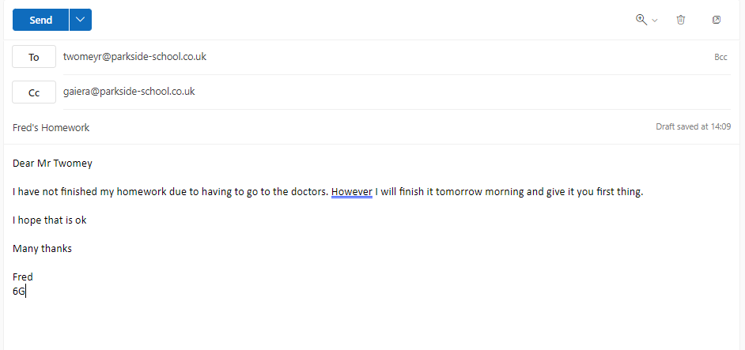
What is a draft?
Sending an item with the email. (photo, document)
Signing your email off
1st paragraph – the reason for your email
What is an attachment?
Inbox
The subject or heading for your email
Addressing the person you want to email
Email of the person you want to send a copy of your email to
What service is our school emails on?
An email that is not yet sent
Button to send the email!
Email of person you want to email
Name of person sending the email
What is it the place where all your emails are stored?
Microsoft Outlook

Slide 2
To: CC:
Subject:
Dear
Many thanks
Write a formal email to Mr Gainer an email asking if he can send you his log in details for canva. Send Watson a copy too

